Slide 1

hackathon.4
The Advanced Analytics Community of Practice (AACoP)
CRM Hackathon Q2 2022

Slide 2
Hackathon TEAMS
CRM Sponsors Gabriel Mouchawar, Jeff Moore, Paul Ryu, Kevin Davis
AACoP Core Team
Leads Jinesh Jain, Richard Heitz
Communications Richard Heitz, Lia Donovan
Teams Lucas Frey, Patrick Price
Data Stephen Stoyan, Jinesh Jain
Results Meghan Ding, Stephen Stoyan
Judge Panel
CRM Gabriel Mouchawar, DVP Product Development
Paul Ryu, Sr Director Product Development
BTS Terry Finch, DVP Digital Technology Services
Nichole Meister, DVP IT Nutrition

Slide 3
Hackathon.4 (CRM)
Key Dates
Data Deep Dive Tue May 3, two sessions: 10 am & 9 pm CST
Hackathon Fri May 6 to Sun May 22
Presentations Wed May 25 (to be confirmed)
Winner Fri May 27
Judging Criteria
50% Quantitative F1 Score (visible on the live Leaderboard)
50% Qualitative PowerPoint Presentation (approach, novel insights, complexity)
Use this slide template
Resources
Microsoft Teams Hackathon channel with data, Q&A. Channel link
Reference Code Read signal data, common data augmentation methods
Live Leaderboard Ranked by F1 Score
Azure Cloud Compute Spin VMs or use Azure Machine Learning
Prizes Top 3 places and participation

Slide 4
Azure Resources
All participants will be granted access to AACoP Azure Subscription – May 5
Login at https://portal.azure.com
Select the AACoP Subscription
You will be preassigned to a Resource Group (RG)
Resource group per team
RGs named after team captain
RGs will have the following permissions:
Create VM (with GPU), create shared AML Workspace, r/w to shared Storage Account
Suggested VM Types:
Standard_D8s_v3: 8 CPU, No GPU, $250/month
Standard_NC6s_v3: 6 CPU, 1 Tesla V100, $2000/month
Access to resources created in the same RG
Write permission to storage account for leaderboard uploads
View current spend, or alerts configured at 50% and 90% spend
Fixed budget per RG - $2,000 (can be increased upon request)

Slide 5
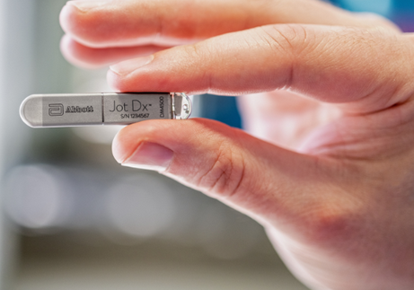
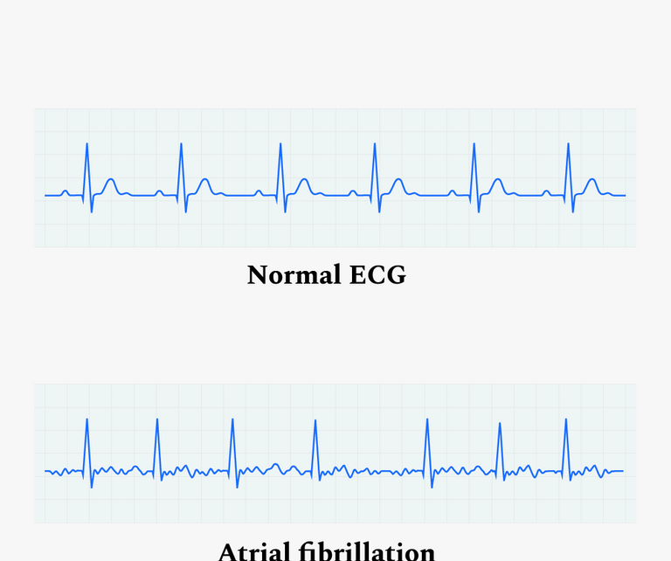
Hackathon.4 (CRM)
Problem: Develop a model to identify Stored Electrograms (SEGM) containing Atrial Fibrillation (AF)
Value: Current industry benchmarks have a specificity of ~75% and sensitivity of ~99%. Improved model performance (increased specificity with no reduction in sensitivity) will reduce AF false positives allowing clinicians to better serve CRM patients
Background: An implantable cardiac monitor (ICM) is a small device that gets implanted in a patient with a suspected heart condition. The ICM monitors the heart’s electrical signal for abnormalities. If one is detected, it saves the SEGM and transmits it to a clinician for review
Accurately diagnosing AF from an electrical recording is difficult, and the device often captures false positive recordings that purport to show AF, but in fact are something different
Dataset: 27,418 SEGMs from 345 Abbott ICMs - 9,030 true positives and 18,388 false positives. Each SEGM is 2-3 minutes long at 128 Hz sample rate

Slide 6


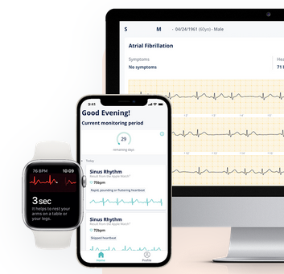
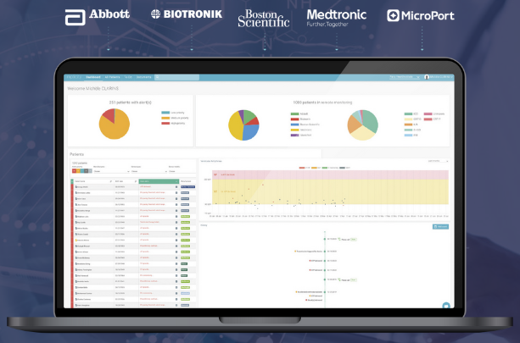
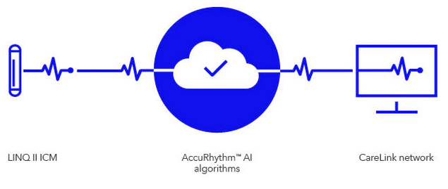
Competitors’ Solutions
www.cardiologs.com
www.implicity.com
www.medtronic.com
Notes:
Paul: Graphically show MDT Implicity and Cardiolog, and AccuRhythm solutions to demonstrate their interest in AI.
Replace slide w/ Jinesh’s version.

Slide 7
hackathon_dataset.csv
640MB CSV file, one example per row.
Contains 27,418 human-adjudicated atrial fibrillation (AF) stored electrograms (SEGMs) from 344 Abbott implantable cardiac monitors.
9,030 are true positives, meaning the device correctly detected AF.
18,388 are false positives, meaning the device incorrectly detected some other condition as AF.

